Slide 1
Structural Foundations
엔지니어링센터
Family : Footing-Rectangular(Non-Pile)
Family Type : FT211_2400x2400x500
지내력 독립기초
Form
Protection
Lean Concrete
철근 0.10 t/m3
Lean Concrete
<Case1> : 별도 Family 적용
Structural Foundation(X) => Floor(O)
<Case2> : 기초 Family에 포함하여 산출
NO | Code | Unit | L01 | L02 | L03 | L04 ~ L11 |  |  |  | BOQ Spec. |  | 3D
1 | A01ZZ001-00004 | M3 | Earth Work |  | Excavation | Soil, Mech. | D < 2.0M |  |  |  |  | Cat.3
2 | A03AC034-00007 | M3 | Concrete Work | Sub-structure Work | Lean Concrete (including Form work) | Cement Type-1 | F'c (Cylinder Strength) ≤ 10MPa |  |  | 10 Mpa |  | Cat.3
3 | A03AC032-00007 | M3 | Concrete Work | Sub-structure Work | Structural Concrete | Cement Type-5 | 25MPa < F'c (Cylinder Strength) ≤ 30MPa |  |  | 25 MPa |  | Cat.1
4 | A03AC035-00001 | M2 | Concrete Work | Sub-structure Work | Form Work (3 time in use) | Flat Form | Dressed Lumber, Plywood or Steel Form(Wood Planks are not Allowed) incl. Chamfer |  |  |  |  | Cat.3
5 | A03AD037-00002 | Ton | Concrete Work | Super-structure Work | Rebar Work | Deformed Bar (Non-Coat.) | 400MPa<Fy≤470MPa |  |  |  |  | Cat.2
6 | A03AE059-00001 | M2 | Concrete Work | Concrete Protective Coating (U/G) | Sheet Membrane |  | Adhesive Rubber Sheet or Bitumen Polyethylene Laminated Waterproofing Membrane |  |  | THK=( )mm |  | Cat.3
7 | A03AE060-00001 | M2 | Concrete Work | Concrete Protective Coating (U/G) | Membrane Protection Board |  | Bitumen Impregnated Fiberboard |  |  |  |  | Cat.3
 |  |  |  |  | Construction Joint |  | Concrete Work.에 포함되도록 spec. 작성 |  |  |  |  | X

Slide 2
Walls
엔지니어링센터
Family : Basic Wall (System Family)
Family Type : WA310_Ext. Cavity Wall Block_100-50-200
Above Ground
Block Cavity Wall
Int. : Paint
Ext : Paint
NO | Code | Unit | L01 | L02 | L03 | L04 ~ L11 |  |  |  | BOQ Spec. |  | 3D
1 | A04AK069-00003 | M2 | Finishing Work | Masonry Work | Reinforced Concrete Block | w/ All Reinf.(Lath, Steel Tie, Anchor Bar, Mortar, ETC.), Filler, Sealant, Lintel/Sill for Opening, ETC. | THK≥200mm |  |  | THK=(100-50-190)mm |  | Cat1 (Family반영)
2 | A04AK076-00001 | M2 | Finishing Work | Masonry Work | Insulation | Mineral Wool | Minimum Density of 50 kg/m3 | 50mm≤THK<75mm |  | THK=(50)mm |  | Cat1 (Family반영)
3 | A04AL077-00001 | M2 | Finishing Work | Painting Work | External Wall Painting | Acrylic Emulsion Paint |  |  |  |  |  | Cat1 (Family반영)
4 | A04AL078-00002 | M2 | Finishing Work | Painting Work | Internal Wall Painting | Water Emulsion Paint |  |  |  |  |  | Cat1 (Family반영)
5 | A04AL081-00001 | M | Finishing Work | Painting Work | Skirt Painting | Acrylic Emulsion Paint | 100mm≤H<150mm |  |  | H=(100)mm |  | 별도모델
6 | A04AS164-00001 | M2 | Finishing Work | Plastering Work | Plastering | for External Masonry Wall |  |  |  | THK=(20)mm |  | Cat1 (Family반영)
7 | A04AS164-00002 | M2 | Finishing Work | Plastering Work | Plastering | for Internal Masonry Wall |  |  |  | THK=(20)mm |  | Cat1 (Family반영)
 |  |  |  |  | Damp-Proof Course | 해당 workmaster 없음. Block Work에 포함되도록 Spec. 작성 필요

Slide 3
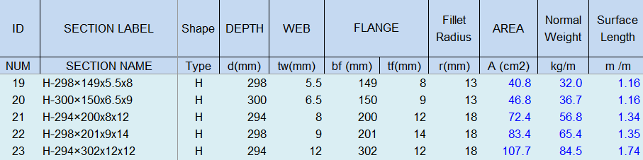
Structural Framing
엔지니어링센터
Family : Steel-H-Beam (System Family)
Family Type : BM121_H-294x200x8x12
철골 규격별 Excel Data ⇒ Dynamo Tool
⇒ 철골 Family 작성
*철골 Family : 단위면적, 단위중량, 단위 표면적 포함
NO | Code | Unit | L01 | L02 | L03 | L04 ~ L11 |  |  |  |  | BOQ Spec. |  | 3D
1 | S01AA002-00001 | Ton | Steel Work | Main Steel Structure Fabrication Work | Medium Steel - Standard (90KG/M>Weight≥30KG/M) |  |  |  |  |  |  |  | Cat.2
2 | S01AA010-00001 | M2 | Steel Work | Main Steel Structure Fabrication Work | Steel Painting/Coating | for Fireproofed Steel Surface, Surface Preparation & Primer Coat |  |  |  |  | Material |  | Cat.2
3 | S03AA028-00001 | Ton | Steel Work | Main Steel Structure Erection Work | Medium Steel (90KG/M>Weight≥30KG/M) |  |  |  |  |  |  |  | Cat.2
4 | F01AC000-00002 | M2 | Fire Proofing Work | Intumescent Coating Type |  | 1 hr. rating (UL 1709) |  |  |  |  | Material |  | Cat.2

